Slide 1
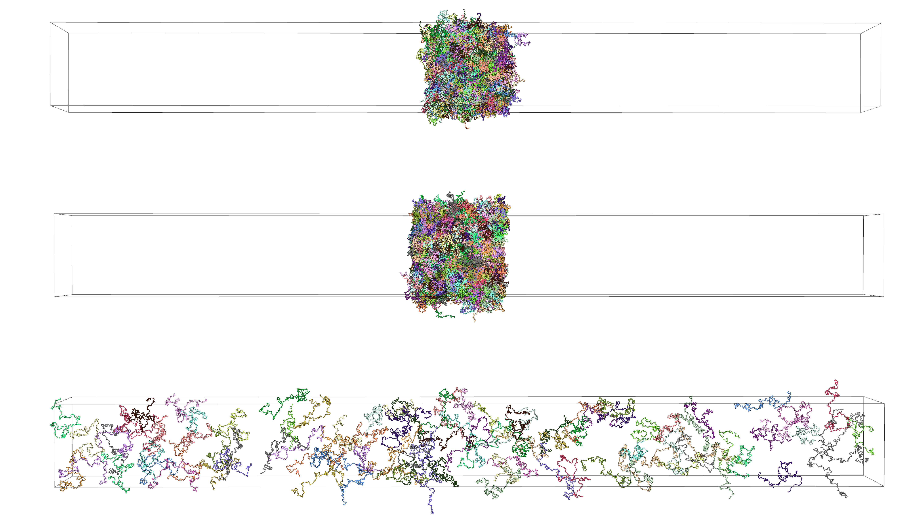
A
B
C
D
RECQ5_{IDR}
CTD
p5-CTD
E
Fig S.17. (A) Representative distribution of the center of mass (CoM) separation distances between the SRI domain and the diheptad of CTD across umbrella sampling windows. Each plot illustrates the CoM separation for a specific window. (B) Free energy profiles for the interaction between the phosphorylated diheptad of CTD (Y1-pS2-P3-T4-pS5-P6-S7) and the SRI domain of RECQ5. The distance between proteins' center of mass (CoM) was systematically reduced from 5 nm to 1 nm and then reversed, confirming the robustness of the sampling through the absence of hysteresis. The binding affinity in Mol is shown for each of the charges placed on the SRI domain. (C) Comparative visualization of the final molecular arrangements in simulations for RECQ5_{IDR}, CTD, and p5-CTD (Y1-S2-P3-T4-pS5-P6-S7). Condensates from RECQ5_{IDR} and CTD formed a slab due to the applied periodic boundary conditions. p5-CTD resulted in a dispersed solution. Each copy of the proteins shown is given a different color to help distinguish their positions. (D) Density profiles of the simulated box with RECQ5_{IDR}, CTD, and p5-CTD along the z-axis. The graph exhibits the local density of molecules within a defined volume. The P-CTD displays a broad distribution roughly equal through out the box, reflecting a gas-like distribution. (E) 70 copies of REQC5 in a 60 x 60 x 60 nm periodic box at the beginning of the simulation (Left) and after 17 μs (Right). Two condensates have formed spontaneously within the simulated timescale, demonstrating RECQ5's ability to spontaneously form condensates. Each RECQ5 is given a different color to help distinguish their positions.

